Slide 1
The comScore Story
Lessons Learned
Magid Abraham
Executive Chairman and co-Founder

Slide 2
comScore is a global leader in digital media analytics
NASDAQ
CLIENTS
EMPLOYEES
GLOBAL COVERAGE
LOCAL PRESENCE
BIG DATA
SCOR ≈ $1.8B Market Cap
2,500+ worldwide clients
2000+ employees
44 markets reported
30+ locations in 20+ countries
1.8 Trillion global interactions per month

Slide 3



































































































We work with 2,500+ clients across the globe
Media
Agencies
Telecom/Mobile
Financial
Retail
Travel
CPG
Health
Technology
Notes:
Key Message
comScore has a wide range of clients worldwide across all industries.
NEED TO VET THIS SLIDE (ANNE, ETC. 17MARCH2017)

Slide 4
Timeline
Startup Period: 1999-2000
The Internet Nuclear Winter: 2001-2003
Path to Public Company: 2004-2007
Securing Market Leadership: 2007-2011
The Advertising Analytics Battleground 2011-2013
CEO Succession: 2011-2014
The Cross Media Future: 2013 – Future

Slide 5
How did we get here?
Started with a big, game-changing idea in 1999
The right starting team
  Four people on the founding team, had worked together before
Classic blood sweat and tears
  But also creativity, scrappiness, and sheer audacity
“Success is how high you bounce after you hit bottom” General George Patton

Slide 6
Early comScore Legends
How we got funded:
  “Those 26 slides”
The Infamous Data Warehouse Negotiation
  Preserving capital was critical in the early days. Needed a data warehouse that would scale
  Today’s environment is much more capital friendly. Leverage it.
    Open source: Hadoop, OpenX, Google Custom Search, Wikis
    Cloud computing
The Hostage Rescue Mission
  “ The PSI Net Story”

Slide 7
Startup Phase: Lessons Learned
Sell credibility and demonstrable potential
Gather a close A level team with well understood chain of command
Choose your VC’s carefully
Stack up the board in your favor
Mind your Corporate Culture:
    Shared identity personified by the founding team
    Leaders must model can do attitude and accountability – zero tolerance for politics
    Innovation: Listen to everyone but maintain your focus
Take as much money as you can WHEN you can

Slide 8
Internet Nuclear Winter
Dot com collapse
Recession
9-11: Impact on Media and Financial Services
Course correction:
      Maximizing the addressable market: Media Metrix acquisition
      Changing the sales model
      Capital preservation
Funding challenges: 3 funding rounds!

Slide 9
Internet Nuclear Winter
Lessons Learned
You are the Prophet of your own Venture. No one believes in a Prophet who does not believe in himself!
Don’t let skepticism overshadow sound judgment
To survive, think fast but act faster!
When you must, take your poison all at once

Slide 10
The Happy Growth Years
Thriving through innovation:
  Identified critical market opportunities and got there first
    Search, Video, Audio Measurement
    Campaign Effectiveness
  Maintained a minimum competitive lead of 2 years
Building network effects:
  Laser focused on winning key influencers: Agencies, Market leaders
  Leveraged the media’s hunger for information
  Thought leadership leads to market leadership
Operated early as a public company to be ready when the time came

Slide 11
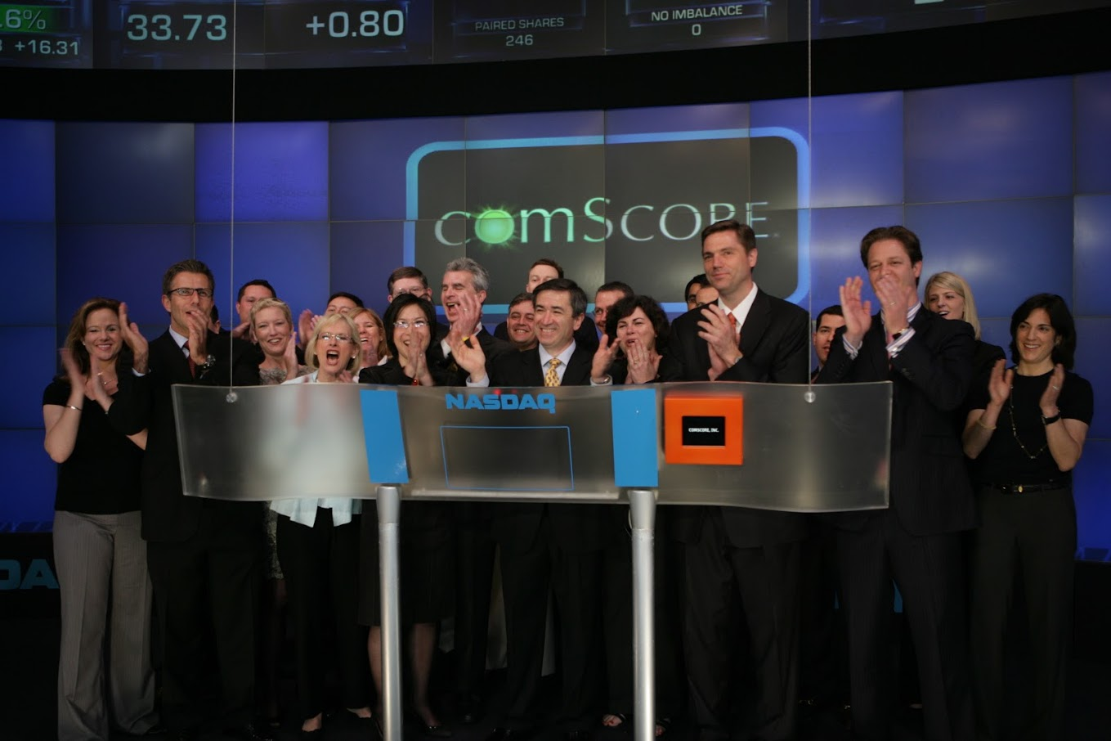
Going Public!

Slide 12




The Happy Growth Years
Strong Track Record of Innovation
1
st
1
st
to Provide Behavioral Ad Effectiveness (Campaign Metrix)
1
st
Video Streaming Measurement
(Video Metrix)
1
st
to Deliver a Worldwide Internet Audience Measurement (World Metrix)
1
st
to Measure the Search Market (qSearch)
1
st
to Build and Project from 2M+ Longitudinal Panel
to Monitor and Report eCommerce Data
External Recognition
WORLD ECONOMIC FORUM
Technology
Pioneer
2007
Top 100
Innovative Companies
December 2004
World’s Largest
Windows Database
December 2001,
2003, 2005
Notes:
Innovation helps us stay ahead
World Economic Forum.
Only one of 6 Internet companies that got the honor

Slide 13
Strategic Pivot: 2009 -2012
Moved to census measurement:
  Scary, big gamble
  “What is it about ‘WE ARE DOING IT’ you don’t understand?
Rethought the basic advertising metrics:
  Served ad impressions -> Validated ad impressions:
    Viewable
    Valid geography
    Delivered to a real user
    On Target

Slide 14
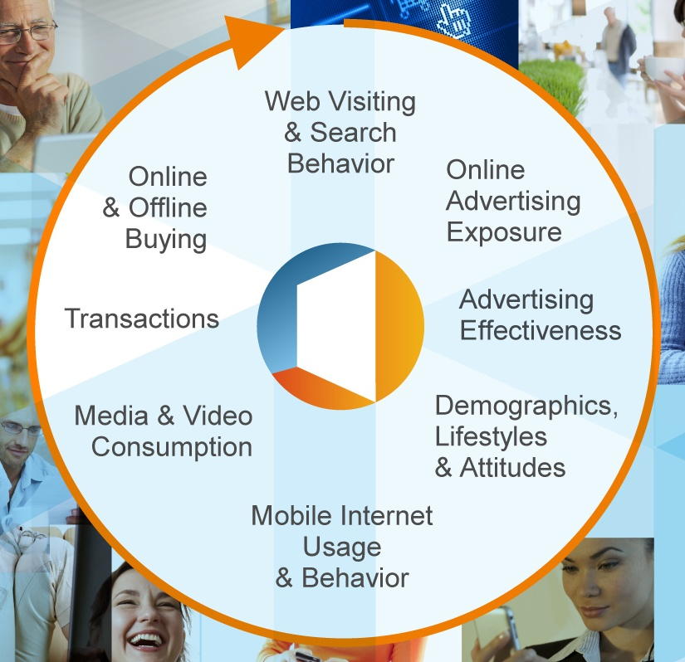




An innovative Pivot: comScore’s global unified database captures
1.5 trillion digital interactions each month
2 Million Person Panel
360º View of Person Behavior
PERSON-Centric Panel with
WEBSITE-Census Measurement
Web Visiting & Search Behavior
Online
& Offline
Buying
Online
Advertising
Exposure
PANEL
CENSUS
Transactions
Advertising
Effectiveness
Media & Video
Consumption
PANEL
Demographics,
Lifestyles
& Attitudes
Unified Digital Measurement™ (UDM)
Patent-Pending Methodology
1 Million Domains Participating
Adopted by 90% of Top 100 U.S. Media Properties
Mobile Internet
Usage & Behavior
Notes:
14

Slide 15
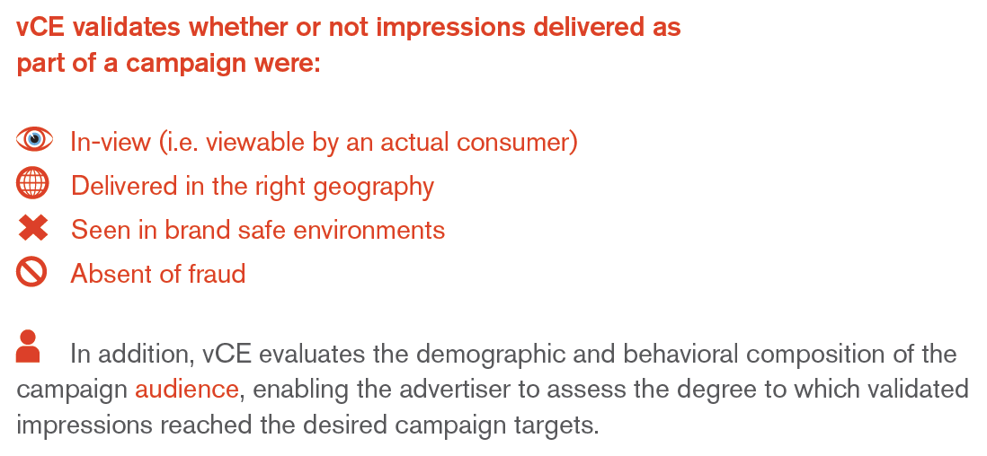
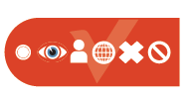
Another Leap: validated Campaign Essentials™
Holistic solution for complete campaign delivery validation and in-flight optimization
Importantly, a single ad tag allows for an unduplicated
accounting of all impressions delivered

Slide 16
vCE Impact: The Yield After Fraud and Viewability is Low
Gross Impressions
Legitimate Gross Impressions
Valid Impressions
43.2%
All Impressions Served by an Ad Server
Filtering out Non Human Traffic (NHT)
Filtering out non Viewable* Impressions
Based on IAB criteria of more than 50% of the ad viewable for at least 1 second
100+ November Campaigns Evaluated by comScore

Slide 17
Anticipating the Future
CEO Succession
New Media Universe

Slide 18


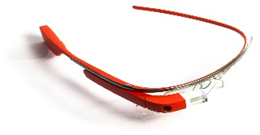
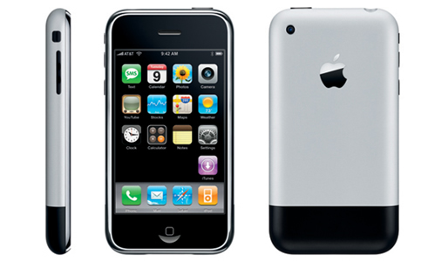

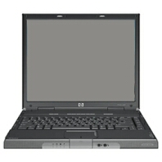
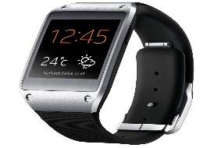
The Challenge of a changing world
2004
2007
2010
Present

Slide 19





comScore’s Total Video Measurement
Nationally Representative STB data
Census Tags
Linear
TV
Total
VIDEO
Digital Video
Person Level Panel
OTT
Video
MP Metered Panels
MP Metered Panels
Census Tags

Slide 20
Timeless Lesson:
People—The Only Lasting Thing
The Real Staying Power
  Technology, Data, Products, Offices, Marketing slogans, even CEOs become obsolete. The only lasting thing is people: Their culture, creative energy, the will to succeed
Talent Development
  Hire the smartest people around: an A+ player > 3 A players> 9 B players.
  Rigorously maintain your hiring standards to prevent talent dilution. The highest ROI on your administrative effort is to build and entrench a rigorous hiring process and talent acquisition strategy
  Preserve your culture, and hire according accordingly. For comScore: Smart, energetic, driven, can do attitude, creative, client oriented
  Be zealous about employee reviews. Make sure people understand what they need to do to succeed, and where they stand
  Bite the bullet on your mistakes and cut your losses early
    Huge cost of mediocrity: morale, productivity, impact on people below

Slide 21
Matching Perception and Reality
Reality = True Values
  Einstein said: “Try not to become a man of success but rather try to become a man of value”
  What kind of company do you want to be? What would your key constituencies say about you?
    Employees: Fair, honest, minimal politics, reward success and hard work. Open communications
    Clients: Deliver on promises, care, partner with key ones
    Competitors: Tough, Smart, Professional, must take seriously,
    Investors: Compelling plan, Accountability
  Stock prices/valuations can go up and down but values are your terra ferma
Perception = Brand Values
  Establish brand values early and be true to them, but from the beginning, plan to evolve
  Tie values to user experience/value proposition
  Spend carefully, measure results rigorously

Slide 22
Critical Relationships
Investors/VCs
  The right VC partner is as important as the firm
  They know you value their interests: Make them money
  Over-communicate and minimize surprises
Board
  Supportive board
  Understands the business
  Understand entrepreneurs
Media
  PR is a very powerful tool
  Know the critical media people in your business and get to know them
  Understand how you make them successful. Give them information that adds value to them rather than just you.

Slide 23
Critical Relationships
Clients:
  Very important
    Write your paychecks, validate your products, can be the source of your best ideas, keep you honest
  Maintain a close relationship with Core/Bellweather clients:
    Handful of clients that can set your directions. You need to know them personally, They should think of you as a partner.
  Maintain your reputation
    Think carefully about the expectations you set ad deliver on them: Product, Client service, Contractual and pricing relationships
Renewal rate is One of the Most Important Metrics

Slide 24
Summary: What Worked For Us…
- Big, unique, executable idea
- Ability to think big
- Strong, scrappy team with good chemistry
- Smart capital
- Right board
- Relentless innovation
- Ability to both see and seize opportunities
- Guts and audacity
- Strong company culture
- Blood, sweat, tears!

