Slide 1

George Akiki
LebNet, President & Co-Founder
May 29, 2015

Slide 2
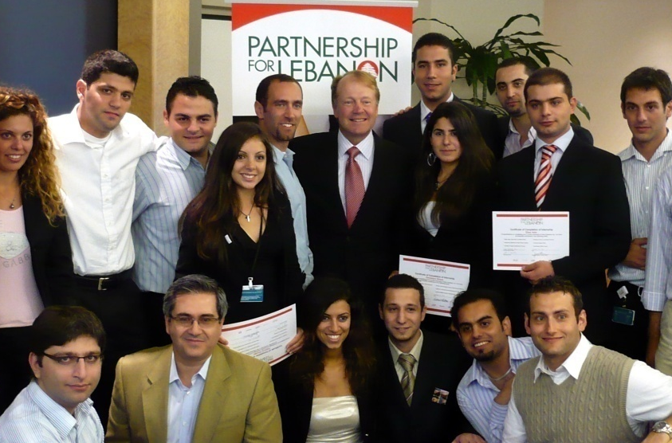
THE PASSION OF GIVING BACK

Slide 3
LebNet Fact Sheet
Lebanese American High Tech professional Society
350+ members
Executives, Entrepreneurs, Researchers, VC fund Managers, & Engineers
Technology, Life Sciences, ICT Support, Business Acumen, and Silicon Valley Know-How.
15+ years old
501 (c) 3 US based organization
Physical meetings focused in Silicon Valley, CA
Notes:
Silicon Valley-based Lebanese diaspora network of technologists and entrepreneurs

Slide 4
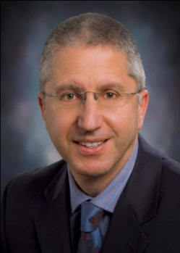
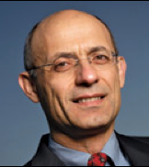

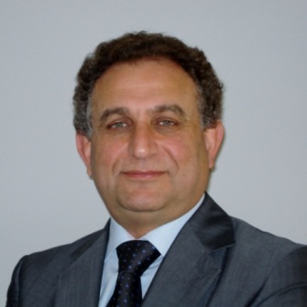
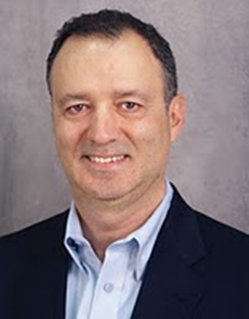
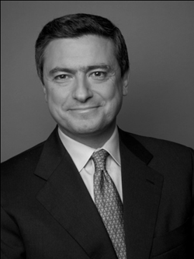
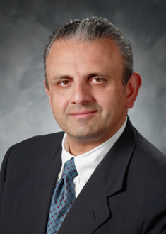
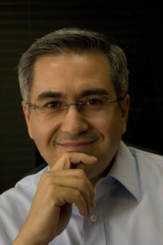
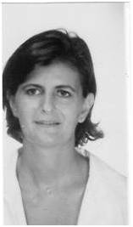
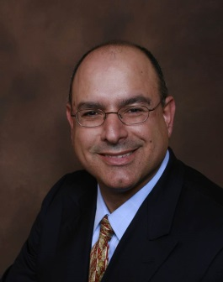
Lebnet Governance
BOARD of Directors
Executive Director
George (Abdo) Kadifa
Elie Habib
Edgar Masri
Khaled Nasr
Eddy Tabet
George Skaff
Fares Mubarak
Najib-Khoury Haddad
George Akiki
Ford Tamer (Board Observer)
Michelle El-Khoury Tager
OFFICERS
General Councel
George Akiki (President)
Fares Mubarak (Treasurer)
Najib-Khoury Haddad (Secretary)
Haitham Ballout
Notes:
George, Khaled, Didier, Harik, Fouad, Ron Papas
Fares, Nassif,

Slide 5
Connect
Lebanon
Nurture
next generation
Network
members
Notes:
Job creation & Economic development
Reversing the brain drain and activating brain circulation
Technology: leveling the playing field
Help create success stories and role models

Slide 6
Connect
Lebanon
Job creation & Economic development
Reversing the brain drain and activating brain circulation
Technology: leveling the playing field
Help create success stories and role models

Slide 7
Why Connect ?
The Middle East is at an inflection point where innovation and technology will play a major part in the development of large sectors and markets in the region
Lebanon needs to compete for its fair share. Technology offers a somewhat leveling field for entrepreneurs and startups to achieve that goal
There is a dire need for Silicon Valley type expertise to provide a differentiated advantage to the Lebanese startups in unlocking commercial value
Lebnet, collectively through its membership, possesses most of the skills, experience, and knowledge that fill the gaps between Lebanese companies and their commercial aspirations
Lebnet members are anxious to give back to Lebanon by sharing their experiences when proven to be beneficial and in an efficient manner

Slide 8
Programs in Flight
Mentorship
US based accelerator program (TBA)
US based Summer internships (TBA)
Networking events in the US with entrepreneur guests from Lebanon
Representation on boards of Lebanese startups and on Investment Committees of Lebanon based VC funds and Accelerators

Slide 9
What works
What doesn’t works
Play to our strength (technology)
Focus our efforts
Fund only when commercially viable
Help those who help themselves
Start conversation with funding opportunity
Entrepreneur’s sense of entitlement
Fear of failing
Relying on Diaspora volunteering only efforts: need structure

Slide 10

Q & A

